Slide 1
Different Views of Data Mining

Slide 2
Concepts Related to Data Mining
Machine Learning
Pattern Recognition

Slide 3
Concepts Related to Data Mining
Machine Learning
Pattern Recognition
Techniques utilized in data mining processes.

Slide 4
Concepts Related to Data Mining
Machine Learning
Pattern Recognition
Database Management Systems
Data Warehouses
Techniques utilized in data mining processes.

Slide 5
Concepts Related to Data Mining
Machine Learning
Pattern Recognition
Database Management Systems
Data Warehouses
Techniques utilized in data mining processes.
The systems that support data mining.

Slide 6
Concepts Related to Data Mining
Machine Learning
Pattern Recognition
Database Management Systems
Data Warehouses
Big Data Analytics
Data Science
Techniques utilized in data mining processes.
The systems that support data mining.

Slide 7
Concepts Related to Data Mining
Machine Learning
Pattern Recognition
Database Management Systems
Data Warehouses
Big Data Analytics
Data Science
Techniques utilized in data mining processes.
The systems that support data mining.
Data mining is a key component to these broad fields.

Slide 8
Concepts Related to Data Mining
Machine Learning
Pattern Recognition
Database Management Systems
Data Warehouses
Big Data Analytics
Data Science
Business Intelligence
Techniques utilized in data mining processes.
The systems that support data mining.
Data mining is a key component to these broad fields.

Slide 9
Concepts Related to Data Mining
Machine Learning
Pattern Recognition
Database Management Systems
Data Warehouses
Big Data Analytics
Data Science
Business Intelligence
Techniques utilized in data mining processes.
The systems that support data mining.
Data mining is a key component to these broad fields.
A particular application of data mining.

Slide 10
A Database View
Process and techniques that connects data warehouses to the discovery of patterns
Data Warehouse
Discovery of Patterns

Slide 11
A Database View
Data Warehouse
Discovery of Patterns
Data Cleaning
Data Integration
Databases

Slide 12
A Database View
Data Warehouse
Data Mining
Discovery of Patterns
Task-relevant Data
Data Cleaning
Data Selection
Data Integration
Databases

Slide 13
A Database View
Data Warehouse
Data Mining
Discovery of Patterns
Evaluation
Task-relevant Data
Data Cleaning
Data Selection
Data Integration
Databases

Slide 14
A Database View
Data Warehouse
Data Mining
Discovery of Patterns
Evaluation
Task-relevant Data
Data Cleaning
Data Selection
Data Integration
Databases

Slide 15
A Database View
Knowledge
Data Warehouse
Data Mining
Discovery of Patterns
Evaluation
Task-relevant Data
Data Cleaning
Data Selection
Data Integration
Databases
Modified figure from Jiawei Han - https://hanj.cs.illinois.edu/bk3/

Slide 16
A Machine Learning View
Particular techniques that connect the input to the output knowledge
Input Data
Classification
Prediction
Ranking

Slide 17
A Machine Learning View
Input Data
Pre- processing
Classification
Prediction
Ranking
Data integration
Feature extraction
Normalization
Feature selection
Dimension reduction

Slide 18
A Machine Learning View
Input Data
Pre- processing
Model Training
Classification
Prediction
Ranking
Machine Learning Algorithms
Supervised Learning
Unsupervised learning
Semi-supervised learning
Reinforcement learning
Data integration
Feature extraction
Normalization
Feature selection
Dimension reduction

Slide 19
A Machine Learning View
Input Data
Pre- processing
Model Training
Post- processing
Classification
Prediction
Ranking
Machine Learning Algorithms
Supervised Learning
Unsupervised learning
Semi-supervised learning
Reinforcement learning
Data integration
Feature extraction
Normalization
Feature selection
Dimension reduction
Model testing/evaluation
Model selection
Model interpretation
Model visualization

Slide 20
A Machine Learning View
Input Data
Pre- processing
Model Training
Post- processing
Classification
Prediction
Ranking
Machine Learning Algorithms
Supervised Learning
Unsupervised learning
Semi-supervised learning
Reinforcement learning
Data integration
Feature extraction
Normalization
Feature selection
Dimension reduction
Model testing/evaluation
Model selection
Model interpretation
Model visualization

Slide 21
A Machine Learning View
Data Mining
Input Data
Pre- processing
Model Training
Post- processing
Classification
Prediction
Ranking
Machine Learning Algorithms
Supervised Learning
Unsupervised learning
Semi-supervised learning
Reinforcement learning
Data integration
Feature extraction
Normalization
Feature selection
Dimension reduction
Model testing/evaluation
Model selection
Model interpretation
Model visualization

Slide 22
A Machine Learning View
Data Mining
Input Data
Pre- processing
Model Training
Post- processing
Classification
Prediction
Ranking
Machine Learning Algorithms
Supervised Learning
Unsupervised learning
Semi-supervised learning
Reinforcement learning
Data integration
Feature extraction
Normalization
Feature selection
Dimension reduction
Model testing/evaluation
Model selection
Model interpretation
Model visualization

Slide 23
An Application View: Business Intelligence
Decision Making
Data Presentation
Data Mining
Decision Support Process
Data Exploration
Data Pre-processing/Integration, Data Warehouses
Data Sources

Slide 24
An Application View: Business Intelligence
Decision Making
Data Presentation
Data Mining
Decision Support Process
Data Exploration
Data Pre-processing/Integration, Data Warehouses
Data Sources

Slide 25
An Application View: Business Intelligence
Decision Making
Data Presentation
Data Mining
Knowledge Discovery
Decision Support Process
Data Exploration
Data Pre-processing/Integration, Data Warehouses
Data Sources

Slide 26
An Application View: Business Intelligence
Decision Making
Data Presentation
Knowledge Evaluation
Data Mining
Knowledge Discovery
Decision Support Process
Data Exploration
Data Pre-processing/Integration, Data Warehouses
Data Sources

Slide 27
An Application View: Business Intelligence
Decision Making
Business Decision
Data Presentation
Knowledge Evaluation
Data Mining
Knowledge Discovery
Decision Support Process
Data Exploration
Data Pre-processing/Integration, Data Warehouses
Data Sources
Modified figure from Jiawei Han

Slide 28
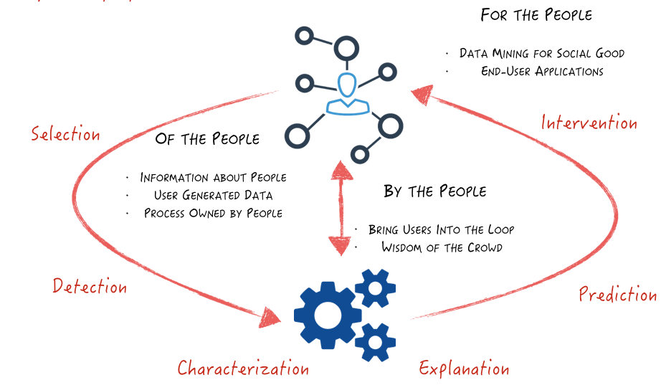
A Human-Centered View

Slide 29


School of Information, University of Michigan
Qiaozhu Mei
School of Information
All Content © Presenter

